Slide 1
NewPOS 6.5 Training – Drive Thru Sequencing
Training QA For McDonald’s
Author: Edgar Cortez
Adapted from SS6x Drive Thru Sequencing STB v4[1].0

Slide 2
NewPOS Drive Thru Sequencing
NewPOS delivers enhanced drive-thru solutions.
Functionality includes ALL Drive Thru types: Single post, Inline Tandem, Dual Lane, Tandem Face-to-Face, Single post with Handheld Order Taker (HHOT) in Tandem mode.
Configured by installer to match appropriate & required equipment per each type
Drive Thru sequencing is uniquely managed by DT type to reduce out-of-sequence orders.
8-cell DT order screen with held orders starting in cell #8.
Allow Front Counter (FC) registers to become DT order takers with full matching functionality.

Slide 3
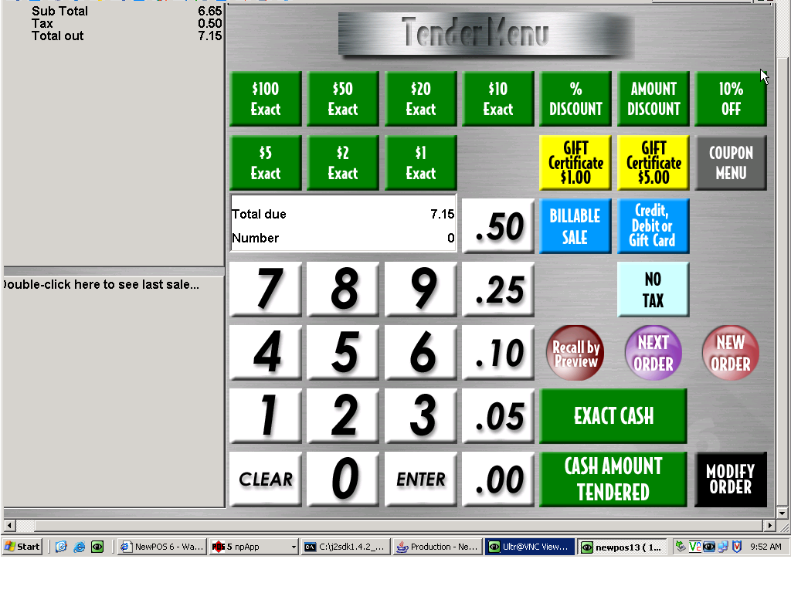
NewPOS Drive Thru Sequencing
Single Lane Drive Thru – Next Car
NEXT ORDER functionality allows the cashier to recall an out-of-sequence order and tender it.
NEW ORDER functionality enables the cashier to select the correct car/order. The Cashier is asked if this is a Multi-order or a New Order.
AUTO RECALL functionality in all DT modes (except Dual Lane & Face-to-Face) speeds the cashier function by automatically recalling next order after cash function is finished.

Slide 4
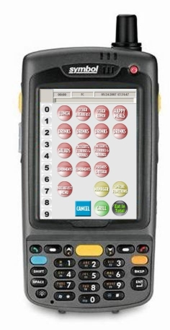
NewPOS Drive Thru Sequencing
Drive Thru with HHOT
This solution can convert any existing single post DT into a Tandem restaurant as needed:
(1 static order point & 1 HHOT order point).
Unique Header identification to accurately recognize HHOT orders on KVS and Expo monitors.
All order taking functionality is consistent with POS order taker.
Default configurations with the ability to cater to various DT/FC operational models:
On-the-Fly (DT and FC) (Kitchen always)
On Store (FC Only) (Playplace Table Service)
On Recall from FC Register (FC Lobby use)
Multiple HHOT’s in use at the same time.
Symbol device has other management tool potential.

Slide 5
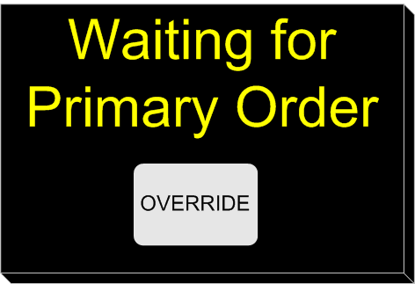
NewPOS Drive Thru Sequencing
Tandem Face-to-Face
Primary and Secondary route orders on-the-fly to the kitchen.
Primary routes on-the-fly to DT Monitor, Secondary does not route to monitor until order is started on Primary, or ‘OVERRIDE’ option is selected.
Secondary has the ability to be configured as either a Cashier or Order Taker / Cashier register.
Primary and Secondary order takers have special sequencing logic.

Slide 6
NewPOS Drive Thru Sequencing
Inline Tandem Speaker DT
During low volume, both order points can be driven by a single Order Taker.
Both Recall and Image Recall can be leveraged.
Primary orders route on the fly to kitchen & DT monitors.
Secondary orders route on Store to DT monitor and on-the-fly to kitchen.
Ability to insert new or add Multi-Car orders to either primary or secondary orders.
Tandem mode routing can be enabled/disabled.

Slide 7
NewPOS Drive Thru Sequencing
Dual Lane Drive Thru
Dual Lane Sequencing:
Orders are displayed on-store on the DT Monitor to align with their approach to cashier.
Image Recall helps match order with customer for enhanced order accuracy.
Ability to overlay actual order on top of the image for further clarification.
Orders shift positions when tendered if selected out of sequence.

Slide 8
NewPOS Drive Thru Type Characteristics
Dual Lane Sequencing:
Orders are displayed on-store on the DT Monitor to align with their approach to cashier.
Dual Order Points: COD 1 and COD 2
Image Recall helps match order with customer for enhanced order accuracy.
Ability to overlay actual order on top of the image for further
clarification.
Orders shift positions when
tendered if selected out of
sequence.
Single Lane:
Orders are displayed on-store on the DT Monitor to align with their approach to cashier.
Single Order Point: COD 1
No Image Recall; however, orders match customer for enhanced order accuracy
Orders are not shifted but in sequential order
Single Lane with HHOT:
Primary order point routes on-the-fly; HHOT routes on store to align with their approach to cashier.
Tandem Order Point: COD1 and HHOT as Secondary
Both Image and Auto Recall helps match order with customer for enhanced order accuracy.
HHOT acts as a secondary order point ; parallels to Tandem-Inline Topology
Orders are not shifted but in sequential ordering.

Slide 9
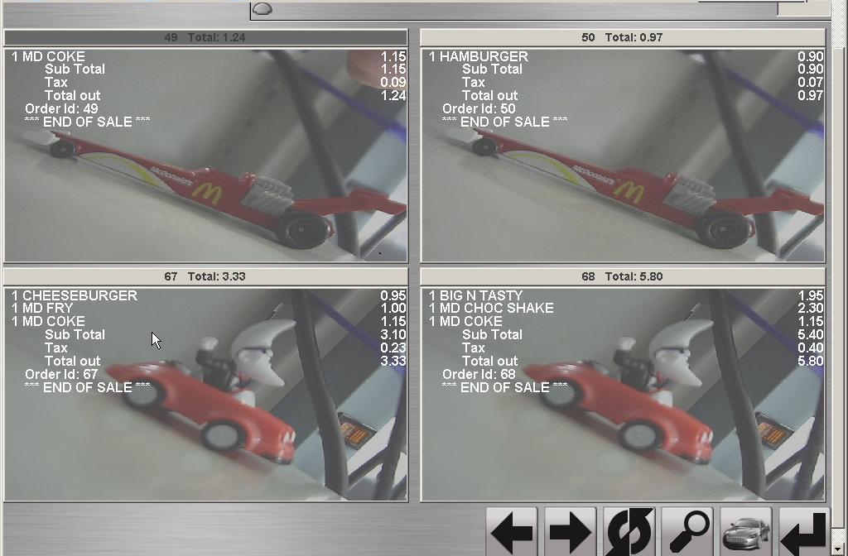
NewPOS Drive Thru Sequencing
Dual Lane Drive Thru – Image Recall
Enhanced Order Accuracy by matching an order to the customer vehicle.
Up to 4 images per screen with scrolling capability.
Images can be superimposed with order details.
Automatic refresh when new orders are stored.
24 Hr Drive-Thru: Orders & images persist during a POS open/close.

Slide 10
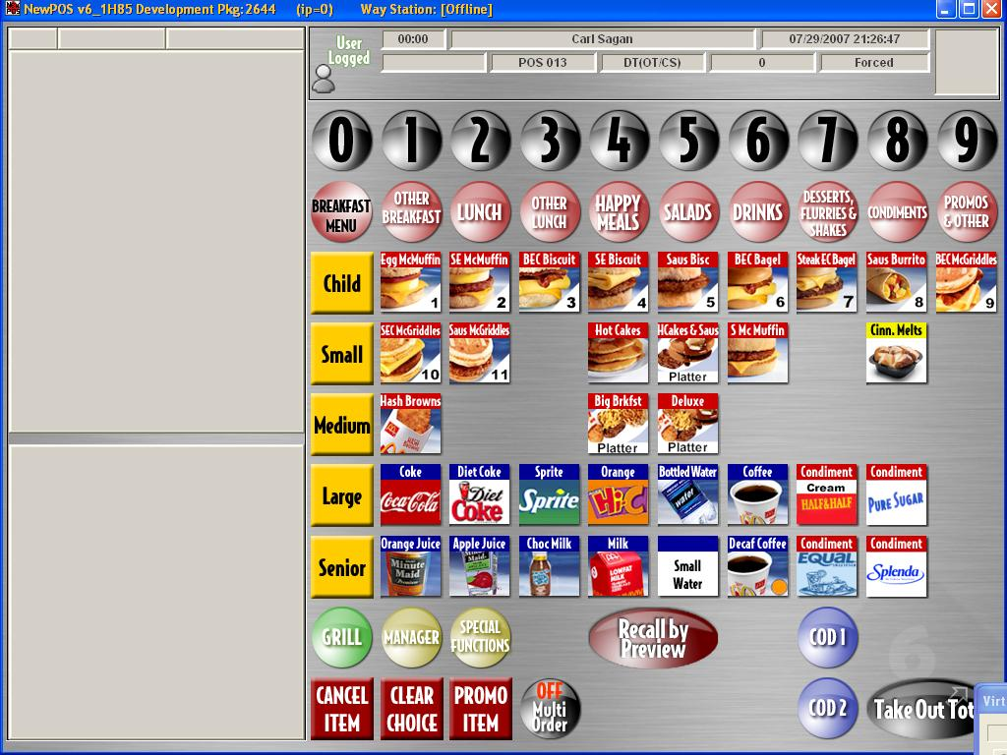
NewPOS Drive Thru Sequencing
Dual Lane Drive Thru
90 key KPA screen
COD Routing
Image Recall
Manager has the ability to change a FC register to a DT register.

Slide 11

NewPOS Drive Thru Sequencing
Order Taker / Cashier Mode
Order Taker/Cashier functionality for the drive thru is now available with NewPOS 6.2.
Allows the flexibility to reconfigure the positioning of the Drive Thru registers at any time.
During overnight operations, a restaurant may configure one register as an OT/CS to facilitate single window operations.

Slide 12
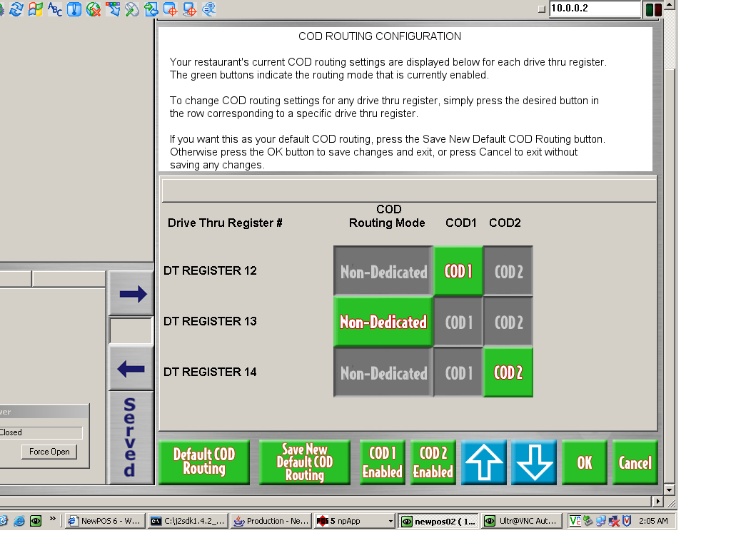
NewPOS Drive Thru Sequencing
COD Routing Configuration
Allows restaurants to easily configure COD routing at the register level for more flexible drive-thru staffing.
Part of “COD Always Working” initiative.
Requires every DT register to be routed
Warnings for each order if COD doesn’t respond.

Slide 13
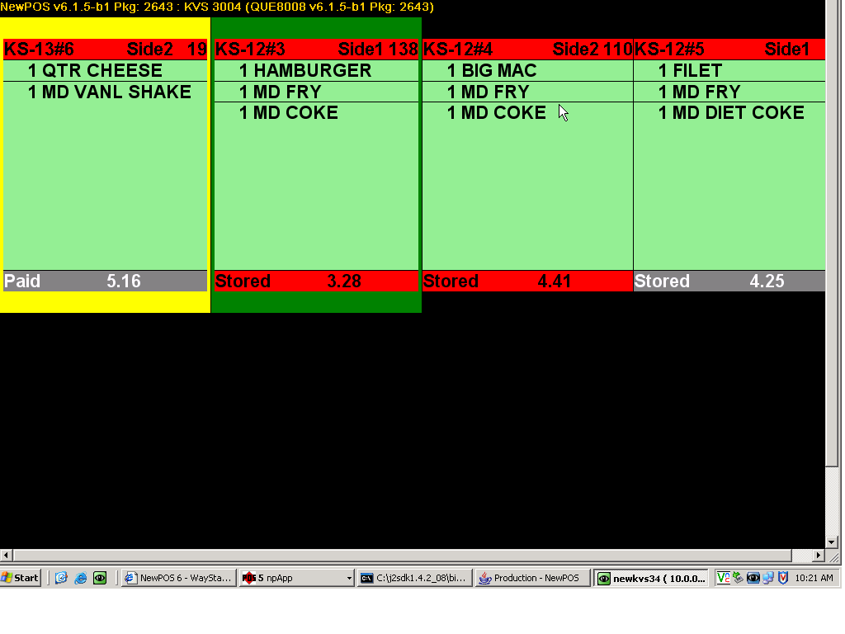
NewPOS Drive Thru Sequencing
Drive Thru Runner Box
Runner Box functionality is consistent with the current SS2.7 Runner Box functionality.
Runner Box works seamlessly for all Drive Thru types.
Feature can be enabled/disabled on-the-fly.
Full “soft bumpbar” support for all functions.

Slide 14
NewPOS 6.5 Training – Drive Thru Sequencing
Support QA For McDonald’s
Discussion
Any Questions?

